Slide 1
CSC589 Introduction to Computer Vision Lecture 3
Gaussian Filter, Histogram Equalization
Bei Xiao

Slide 2
Last lecture
Image can represented as a matrix
Point process
Linear filter: convolution
Wenyan ‘s office hour: Thursday 8pm, DMTI Room 204.

Slide 3
Today’s lecture
More on linear filter, Image Sharpening
Gaussian Filter (introduction)
Image Histogram Equalization
Basic image processing tutorial

Slide 4
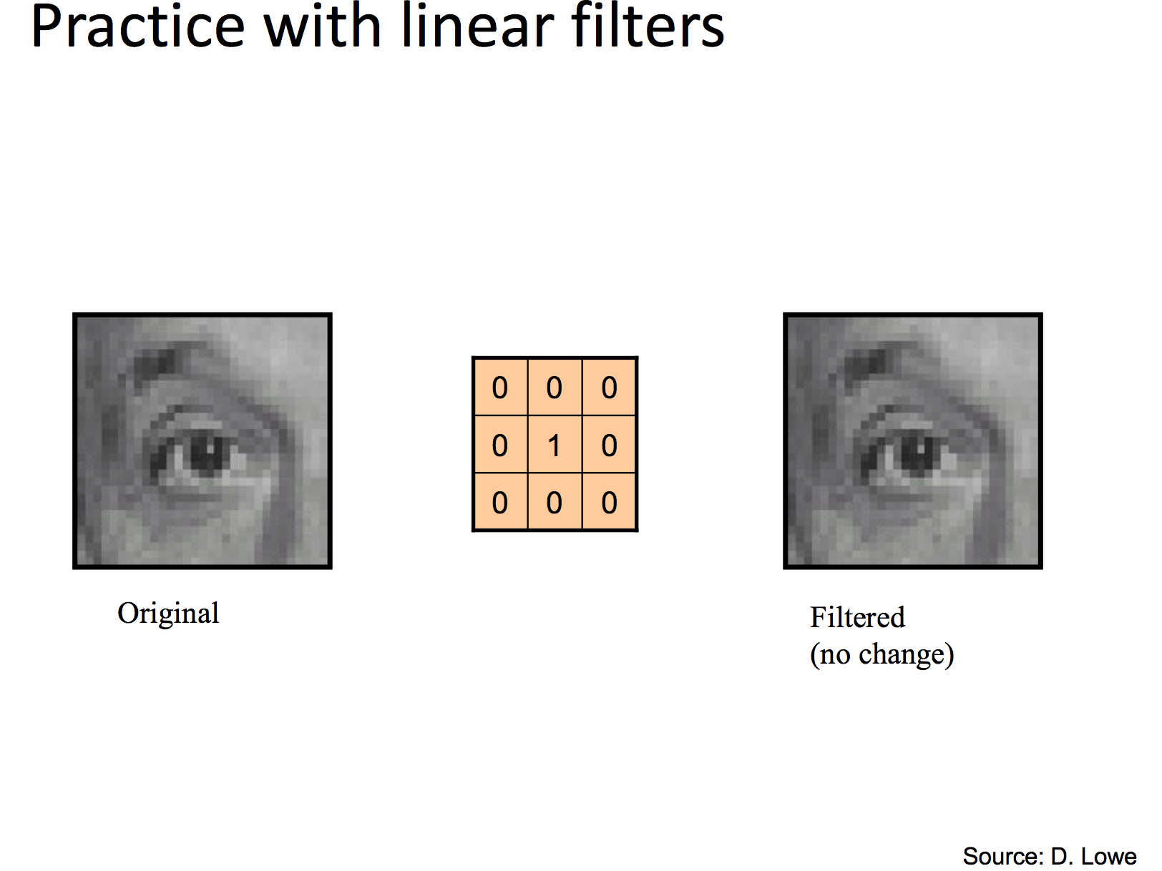
Last time we talked about convolution

Slide 5
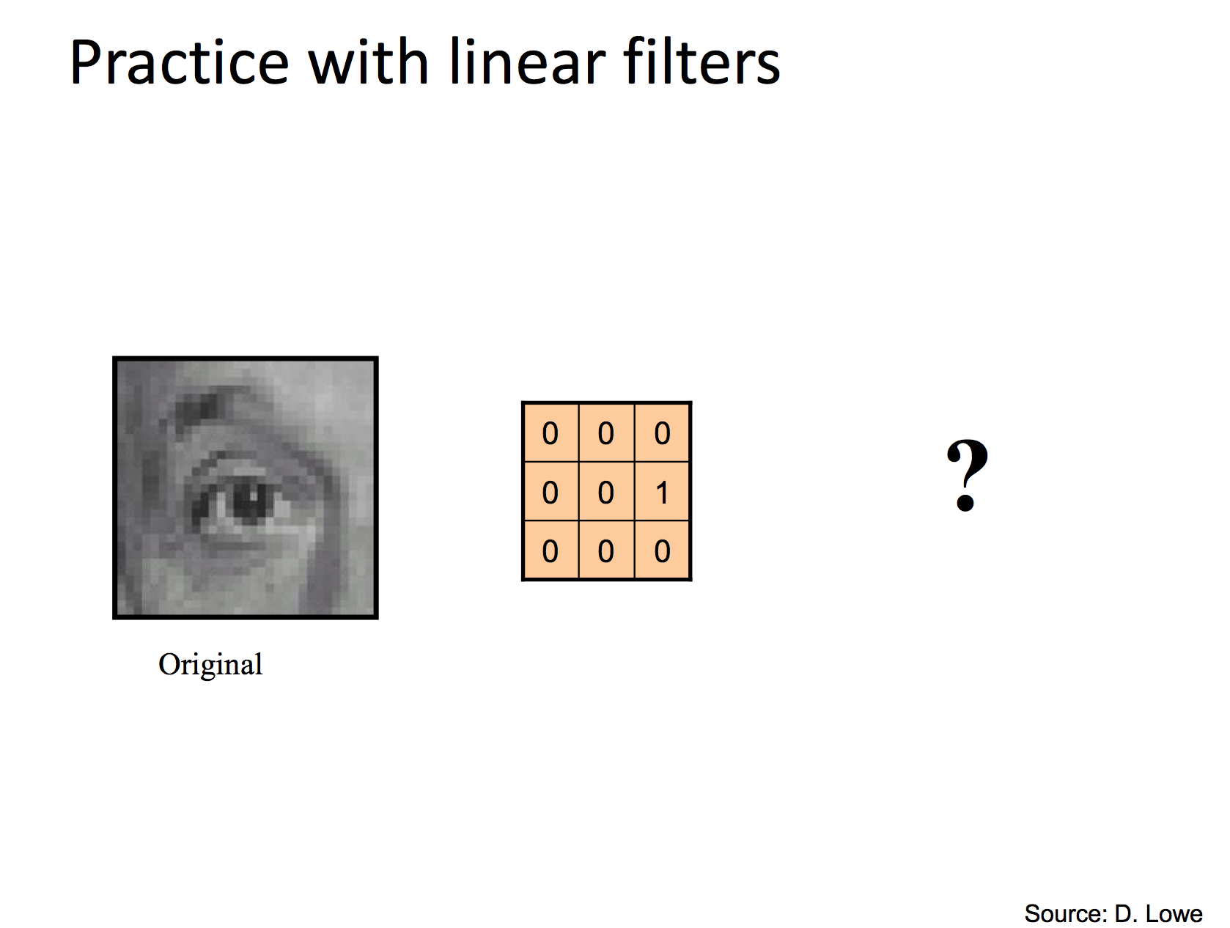

Slide 6
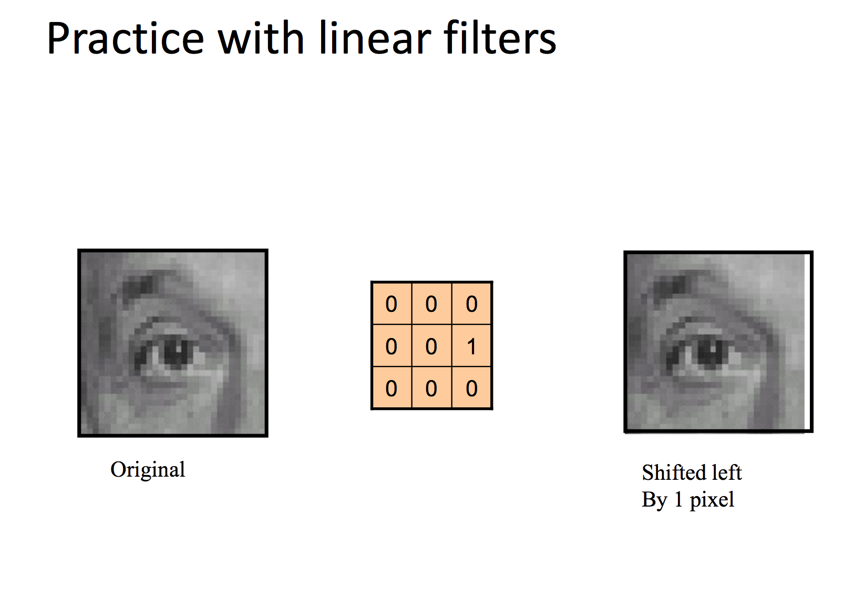

Slide 7
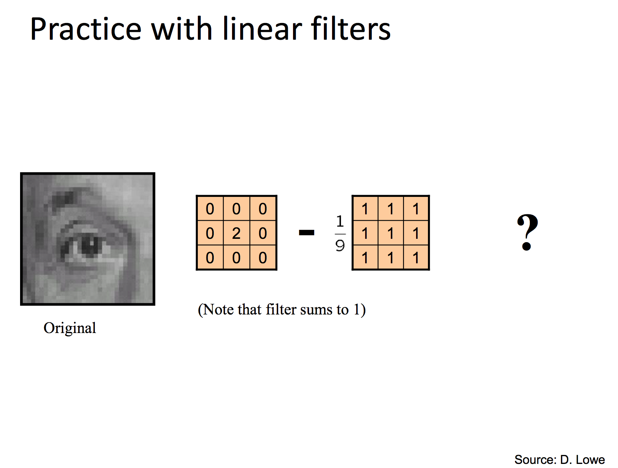

Slide 8
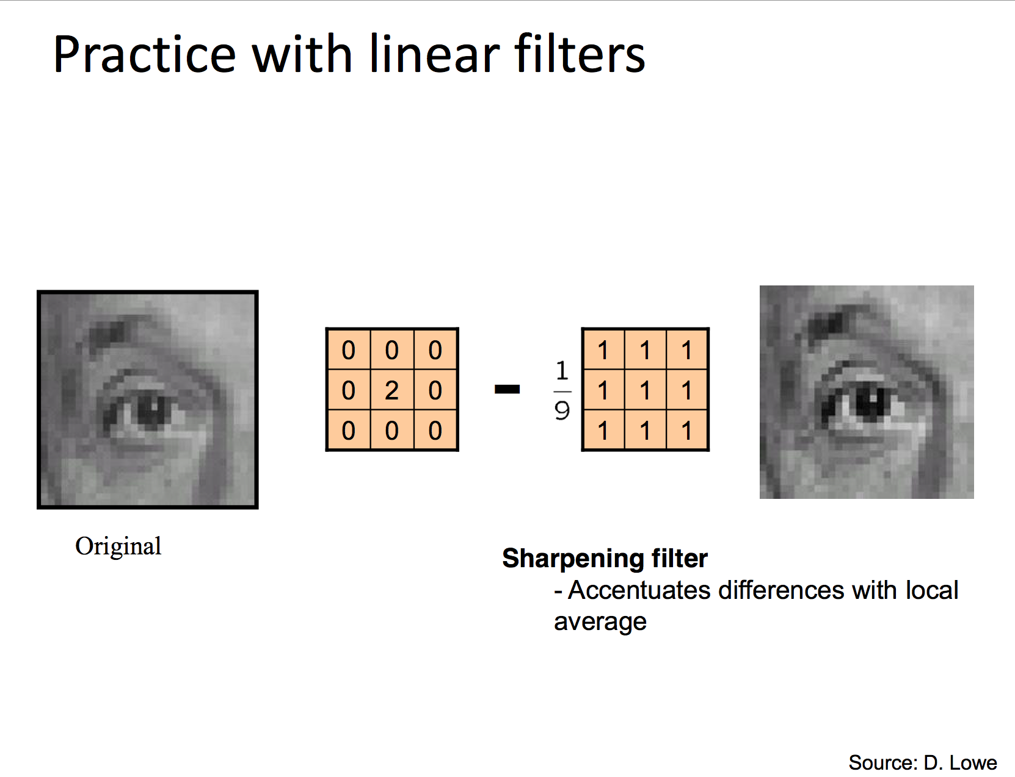

Slide 9
Take home exercises
Find out why the sharper filter works by manually
convolve a 5x5 matrix with the kernel.
Using Python to test all the linear filter operations on images.

Slide 10
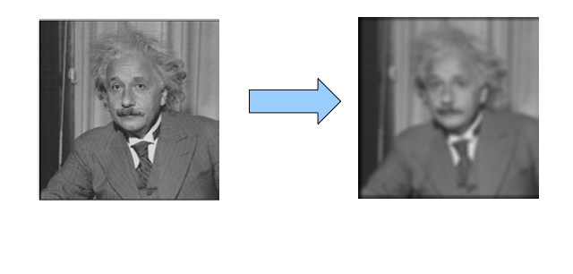
Image Sharpening
Take this image and blur it

Slide 11
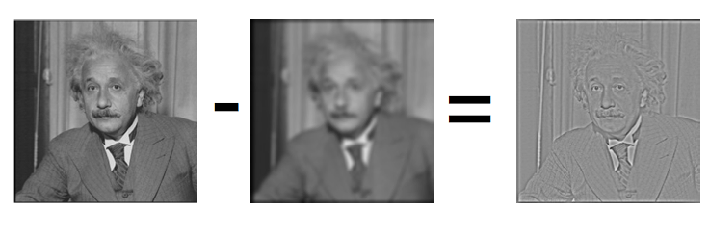
Image Sharpening
What do we get if we subtract this two?
This is the left-over sharp stuff!

Slide 12
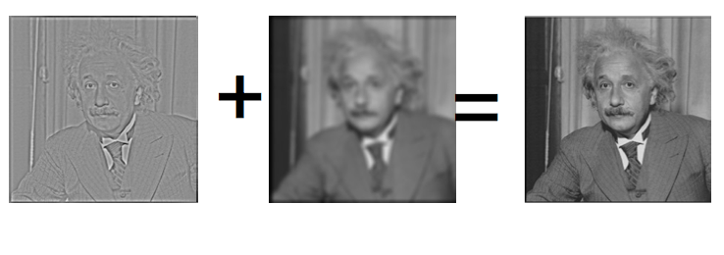
Let’s make the image sharper?
We know: “sharp stuff + blurred = original”

Slide 13
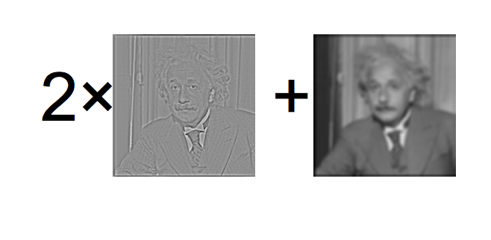
Let’s boost the sharp stuff a little

Slide 14
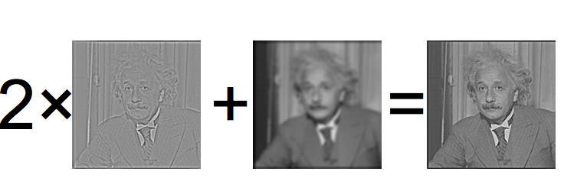
Let’s boost the sharp stuff a little

Slide 15
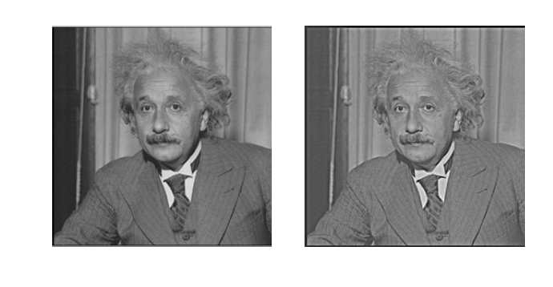
Side by Side

Slide 16
With Python
baby = misc.imread('Kaila.jpg',flatten=1)
## blur
blurred = ndimage.gaussian_filter(baby, 3)
## this is actually the original
filter_blurred= ndimage.gaussian_filter(blurred,1)
alpha = 30
## sharpen
sharpened = blurred + alpha * (blurred - filter_blurred)

Slide 17
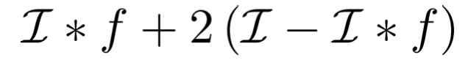
Now look at the computation
Operations
1 convolution
1 subtraction over the whole image
As an equation:
Blur: Convolve with mean filter
Sharpen: original - Convolve with mean filter

Slide 18
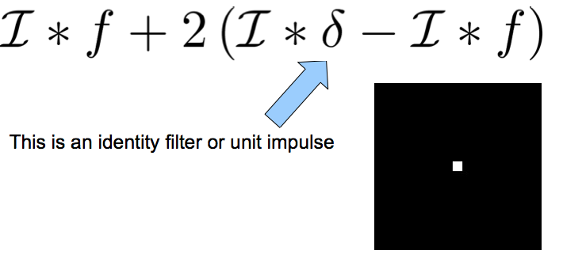
Rewrite this

Slide 19
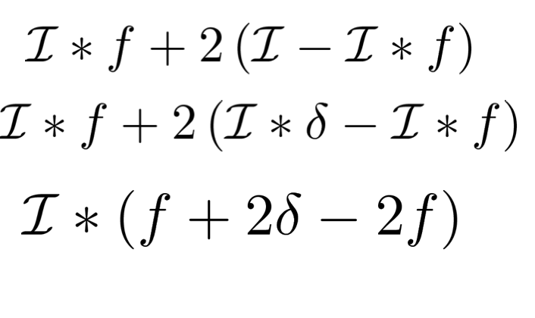
Rewrite this

Slide 20
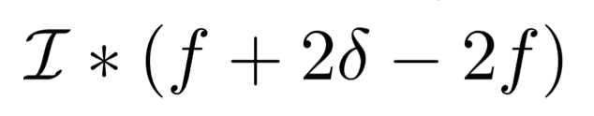
Now look at the computation
Can pre-compute new filter
Operations
1 convolution

Slide 21
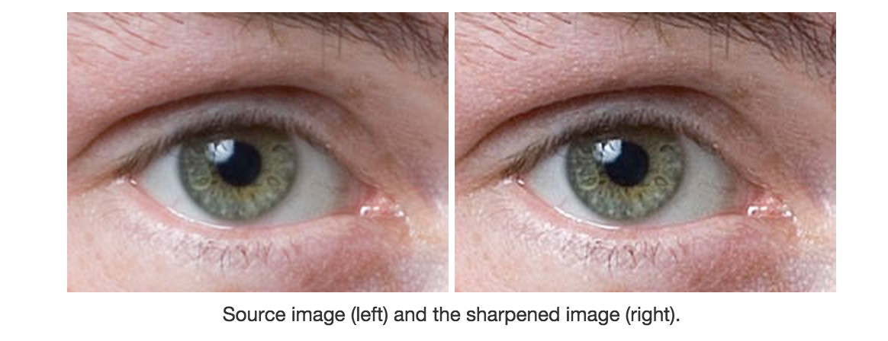
Photoshop: Unsharp Masking
http://en.wikipedia.org/wiki/Unsharp_masking
Notes:
Unsharp masking is a technique common in image processing. The "unsharp" of the name derives from the fact that the technique uses a blurred, or "unsharp", negative image to create a mask of the original image.[1] The unsharped mask is then combined with the positive (original) image, creating an image that is less blurry than the original. The resulting image, although clearer, may be a less accurate representation of the image's subject. In the context of signal processing, an unsharp mask is generally a linear or nonlinear filter that amplifies the high-frequency components of a signal.

Slide 22
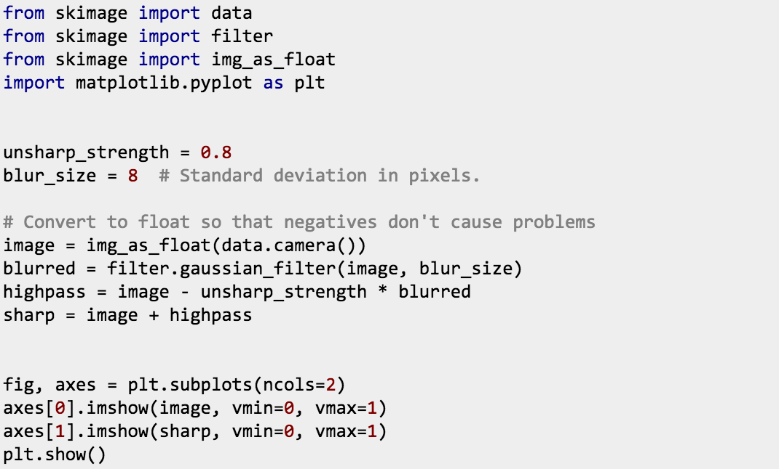
Unsharp Masking (Scikit)

Slide 23
Your Convolution filter toolbox
90% of the filtering that you will do will be either
Smoothing (or Blurring)
High-Pass Filtering (will explain later)
Most common filters:
Smoothing: Gaussian
High Pass Filtering: Derivative of Gaussian

Slide 24
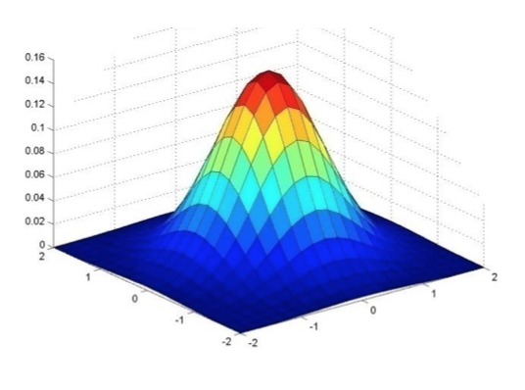
Gaussian Filter
Gaussian = normal distribution function

Slide 25
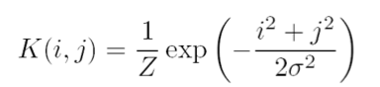
Gaussian Filter
Gaussian = normal distribution function

Slide 26
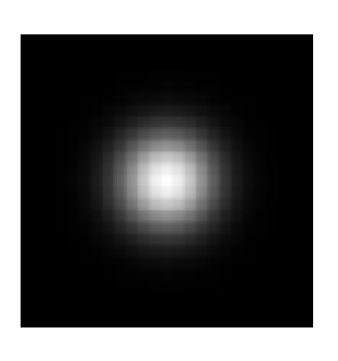
Gaussian Filter
Gaussian = normal distribution function

Slide 27
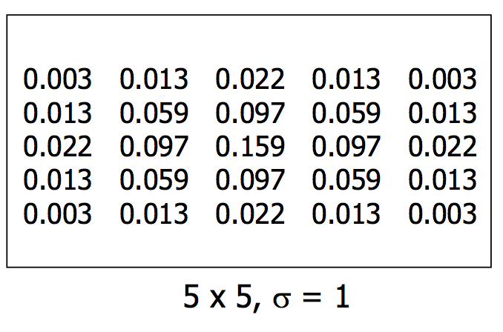
Gaussian Filter
Gaussian = normal distribution function

Slide 28
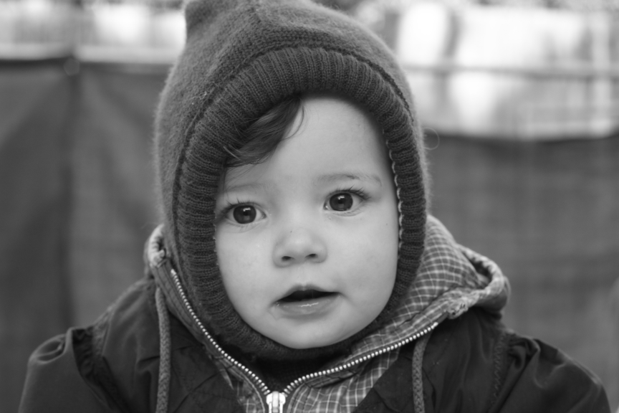



Gaussian filter with different σ
Original
σ = 3
σ = 5
σ = 7

Slide 29
Gaussian Filter
Remove “high-frequency” components from image (low-pass filter)
Images become more smooth
Convolution with self is another Gaussian
So can smooth with small-width kernel, repeat and get same result as larger-width kernel would have.
Convolving two times with kernel width σ is same as convolving once with kernel width σ/2 (Can you proof this?)

Slide 30
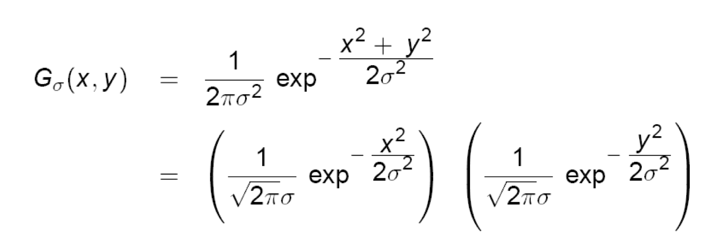
Separability of the Gaussian filter
The 2D Gaussian can be expressed as the product of two functions, one function of x and the other the function of y.
In this case, the two functions are (identical) 1D Gaussian.

Slide 31
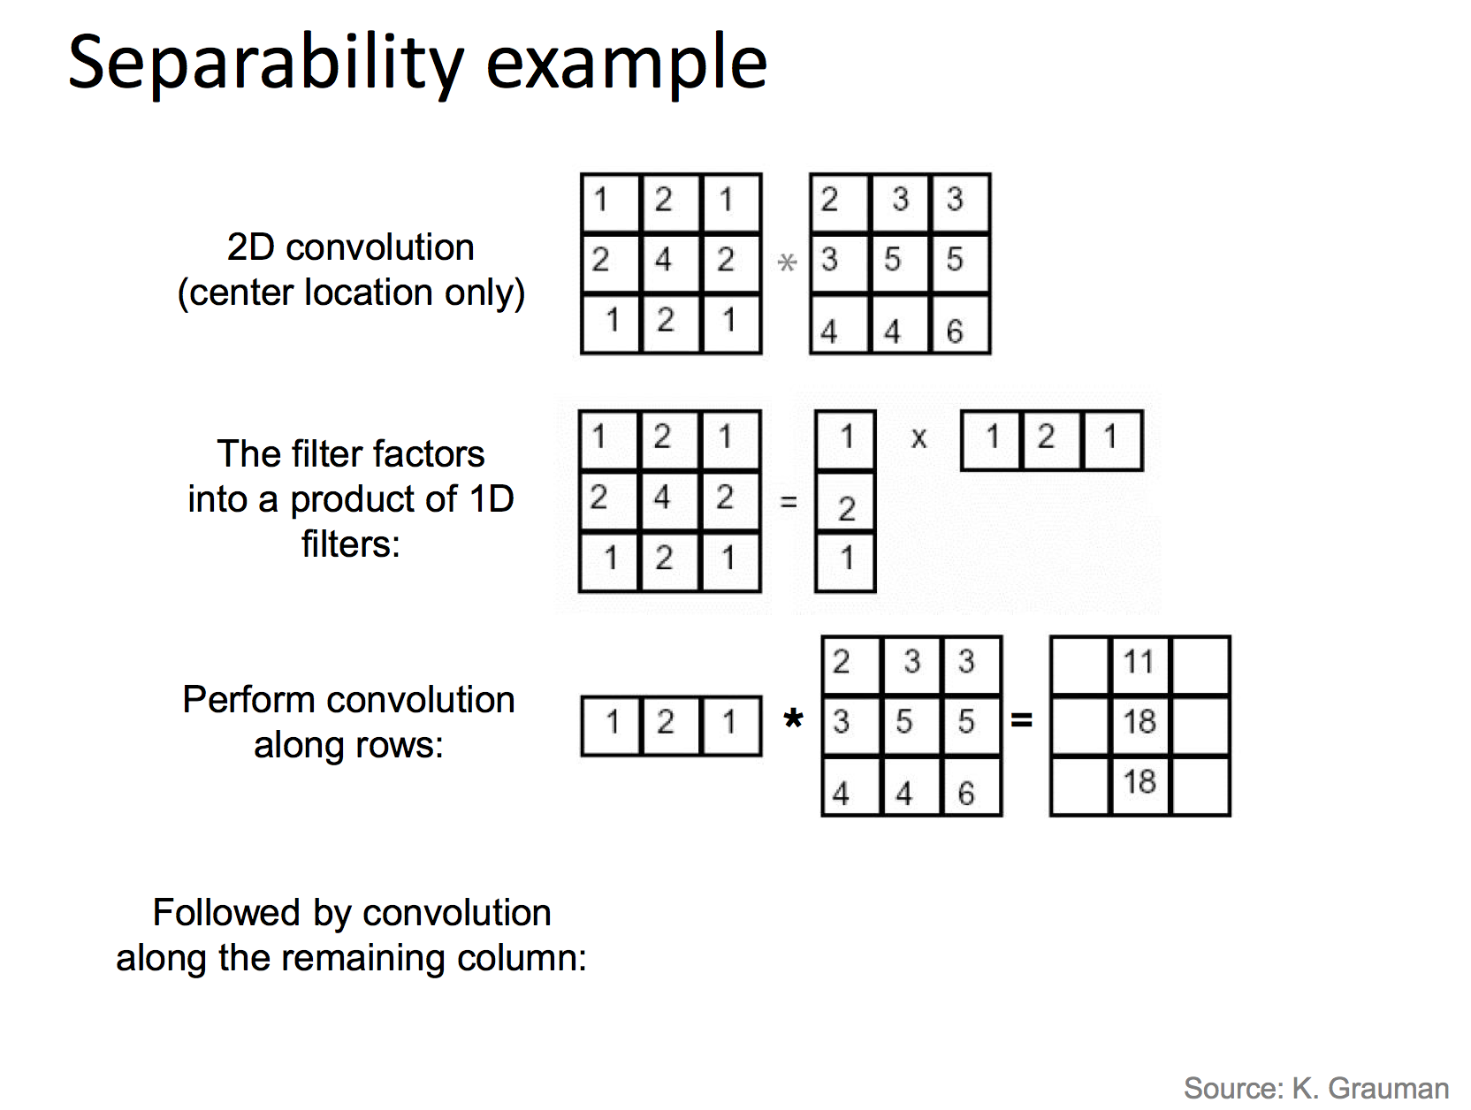
Notes:
>>> a = np.array([[1],[2],[1]])
>>> b= np.array([[1],[2],[1]])
>>> np.outer(a,b)
array([[1, 2, 1],
[2, 4, 2],
[1, 2, 1]])

Slide 32
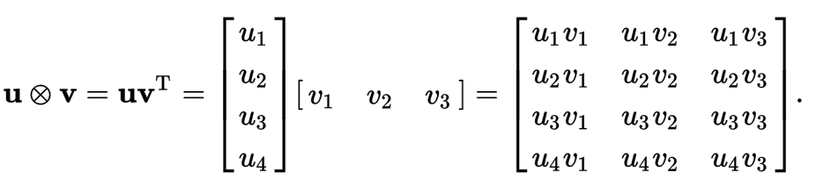
Matrix Multiplication
Notes:
>>> a = np.array([[1],[2],[1]])
>>> b= np.array([[1],[2],[1]])
>>> np.outer(a,b)
array([[1, 2, 1],
[2, 4, 2],
[1, 2, 1]])

Slide 33
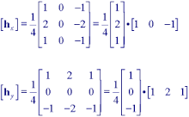

Slide 34
Why is separability useful?
The process of performing a convolution requires K^2 operations per pixel
Suppose v and h are horizontal and vertical kernels.
K = vh^T
2K operations per pixel!

Slide 35
Exercise
Open Lecture 3 and download all the codes and images.
1. Can you write your own function unsharp_mask that takes a blurred image and make a sharper?
2. Can you write a filter that is unsharpmask? That you only have to convolve the image once!
You can use the images in the folder or any other images you can find. Make sure their sizes are not too big.
See lecture notes for details.
Hint: Use filters.gaussian_filter(im,size).

Slide 36
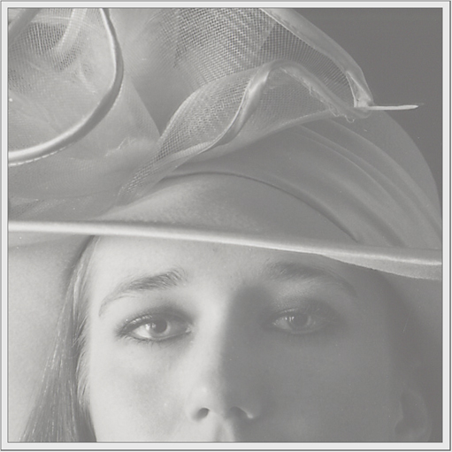
Image Histogram Equalization
We have a low-contrast image:

Slide 37
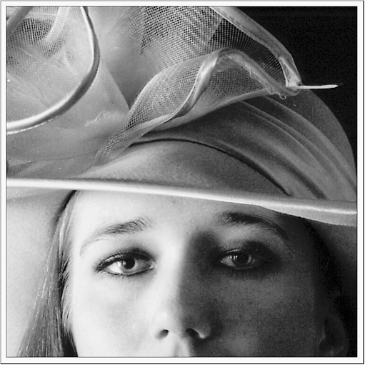
Image Histogram Equalization
We would like to increase the contrast

Slide 38
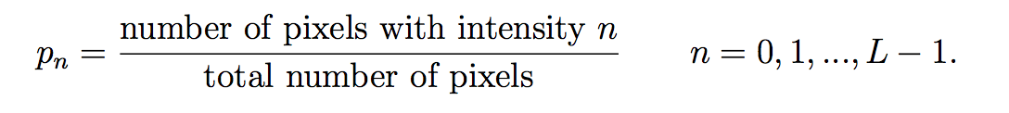
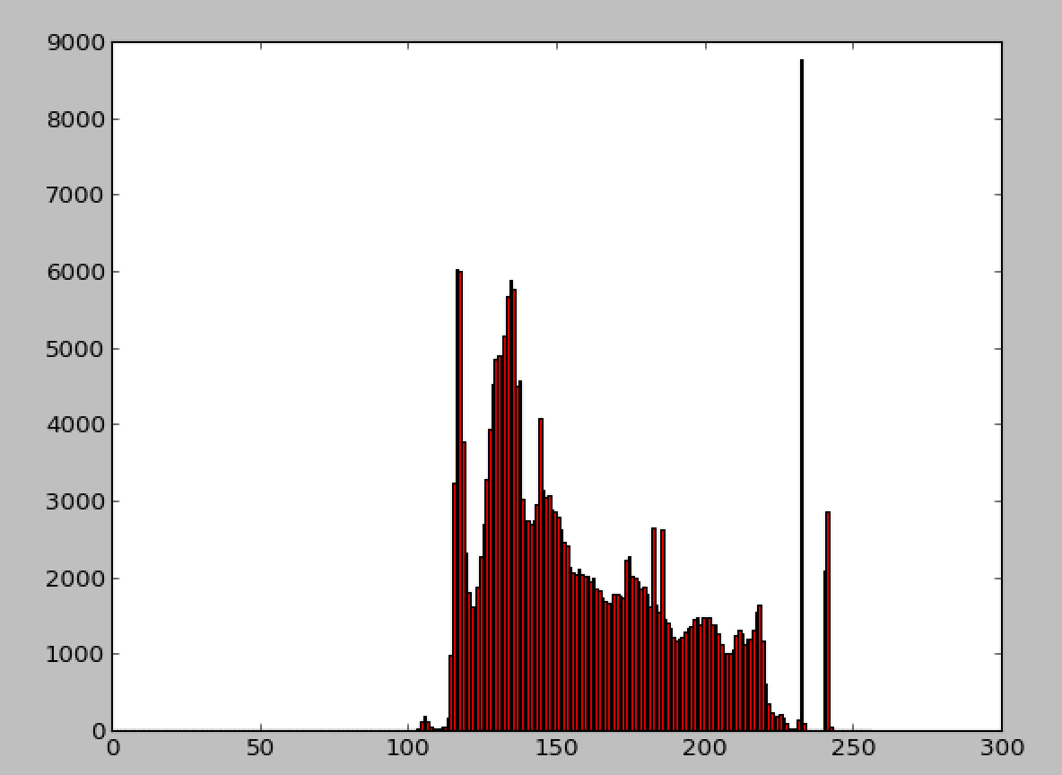
What is a histogram

Slide 39
Image Histogram Equalization
We have a low-contrast image:
Limited image range

Slide 40
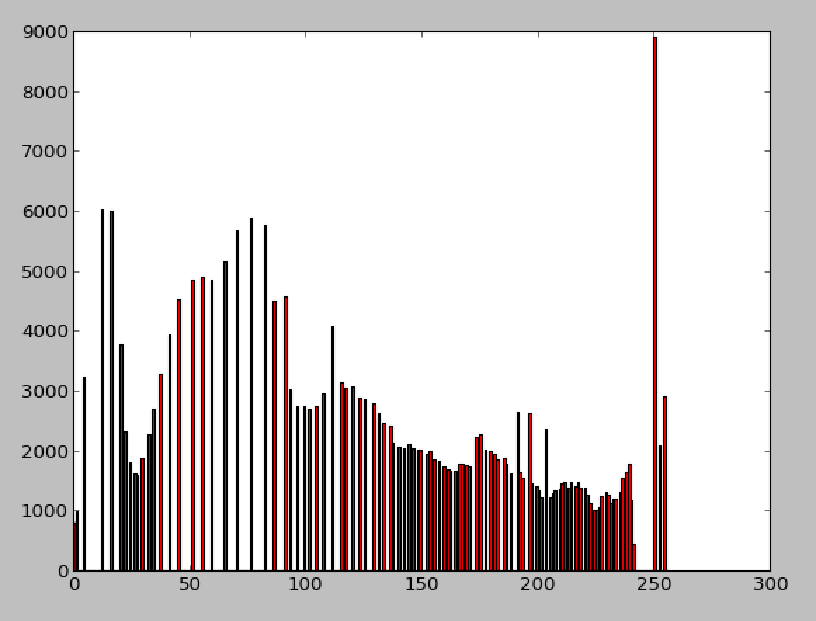
Image Histogram Equalization
What we want is a histogram that covers the whole range of [0,255], but the shape must be preserved!
Ideal histogram

Slide 41
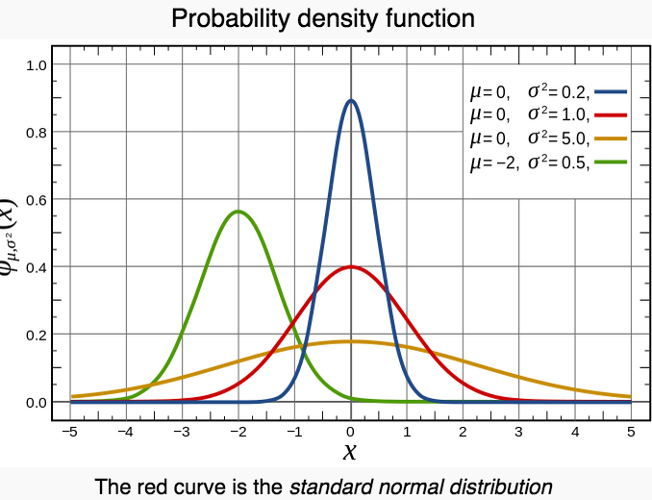
Mini detour of Probability Theory
PDF, density of a continuous random variable, is a function that describes the relative likelihood for this random variable to take on a given value.

Slide 42
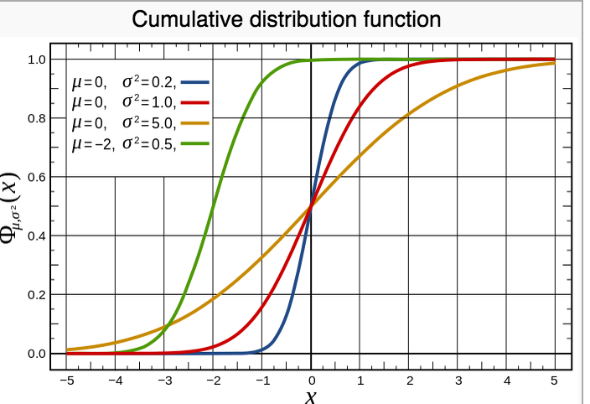
Mini detour of Probability Theory
cumulative distribution function (CDF), describes the probability that a real-valued random variable X with a given probability distribution will be found to have a value less than or equal to x.

Slide 43
How does it work?
Mapping one distribution to another distribution (a wider and more uniform of intensity values) so that the intensity values are spreading over the whole range
The mapping should be the cumulative density function (CDF).

Slide 44
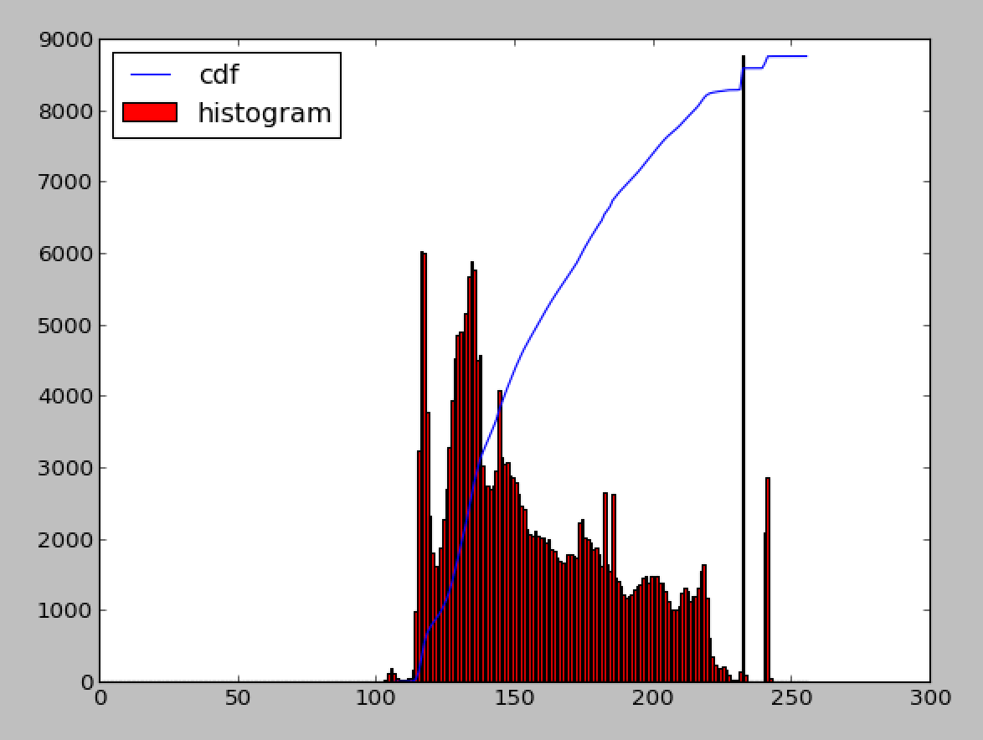
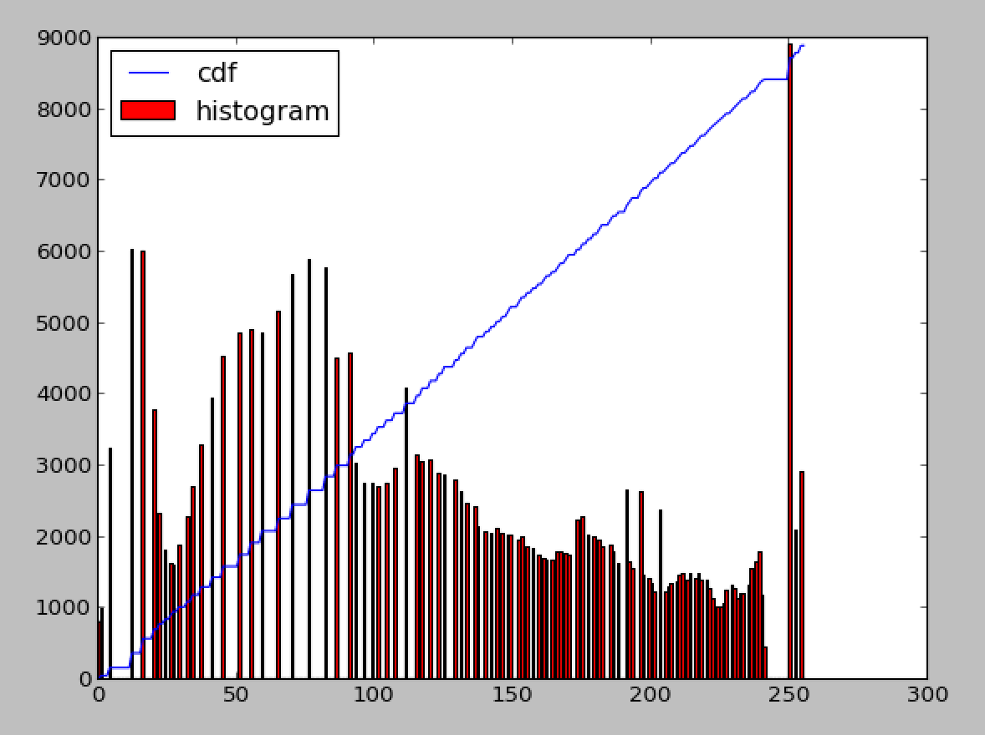
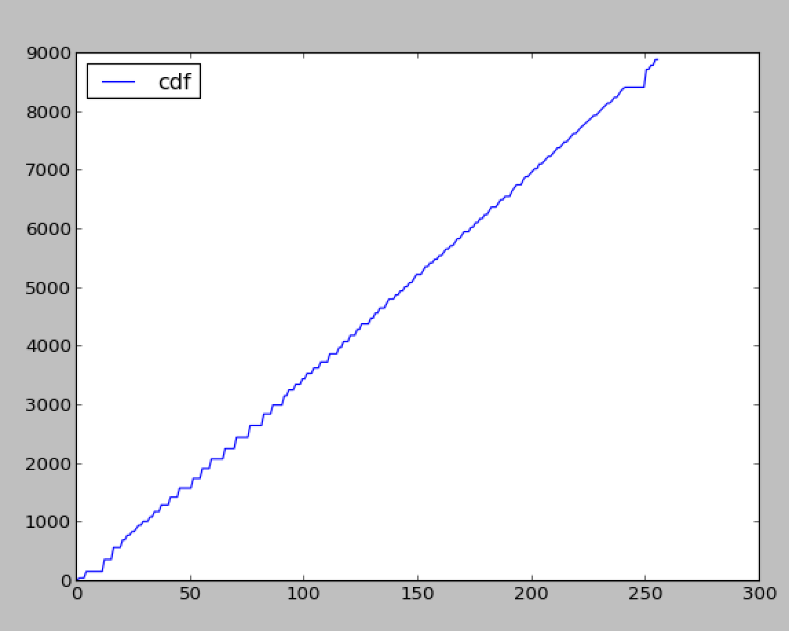
Stretching the CDF
Transform
Before
After

Slide 45
Next class
Bordering effect
Image Derivatives

